Slide 1

DEPARTMENT OF CSE (ARTIFICIAL INTELLIGENCE AND MACHINE LEARNING) ACADEMIC YEAR 2025 - 2026 SEMESTER III ARTIFICIAL INTELLIGENCE LABORATORY MINI PROJECT REVIEW PREDICTING WEATHER CONDITIONS USING PROBABILISTIC REASONING
REGISTER NUMBER | 2117240030028
NAME | DHARRINI SELVI R
YEAR | II
SECTION | A
FACULTY IN-CHARGE | Mrs. M. Divya

Slide 2
PROBLEM STATEMENT
Artificial Intelligence (AI) enables machines to make intelligent decisions and predictions based on data.
Probabilistic reasoning is a key AI application that allows decision-making under uncertainty.
This project addresses weather-based prediction of whether people will play outdoor games.
Bayesian Networks are used to model dependencies between weather variables: Outlook, Temperature, Humidity, and Wind.
Naive Bayes classifiers are used for comparison with probabilistic inference.
The main task is to predict the probability of outdoor play given a set of weather conditions.
The project highlights the importance of intelligent prediction systems that handle uncertainty in input data.
Visualization of the Bayesian Network structure and Conditional Probability Tables (CPTs) is included.
The project also evaluates model performance and compares Bayesian inference with classical machine learning approaches.

Slide 3
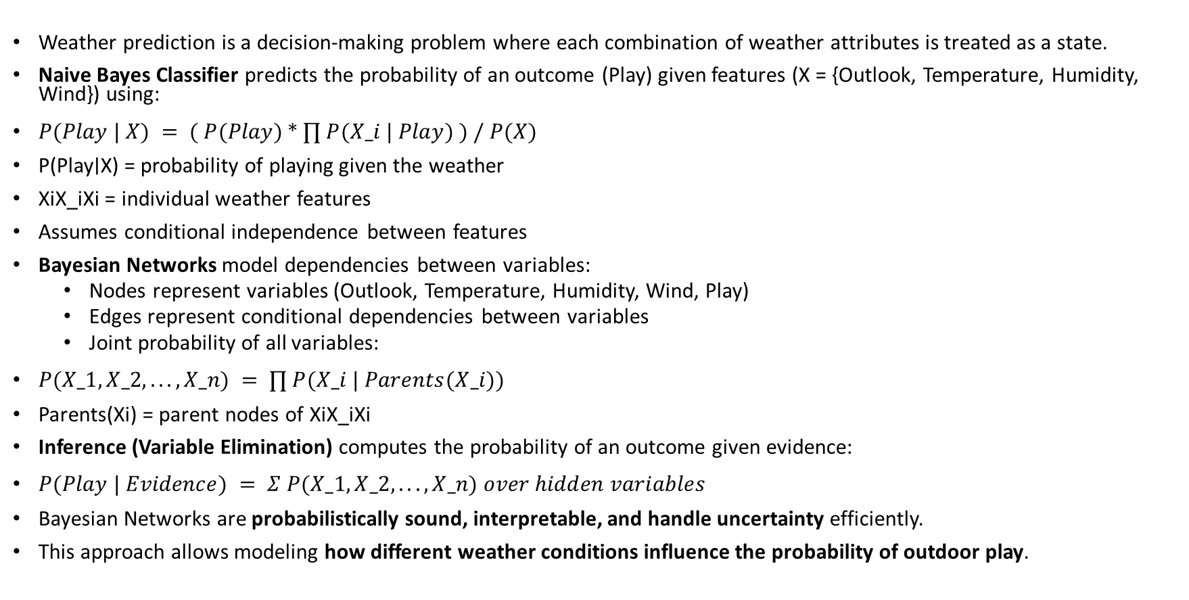
THEORETICAL BACKGROUND
Weather prediction is a decision-making problem where each combination of weather attributes is treated as a state.
Naive Bayes Classifier predicts the probability of an outcome (Play) given features (X = {Outlook, Temperature, Humidity, Wind}) using:
$P(Play | X) = ( P(Play) * ∏ P(X_i | Play) ) / P(X)$
P(Play∣X) = probability of playing given the weather
XiX_iXi​ = individual weather features
Assumes conditional independence between features
Bayesian Networks model dependencies between variables:
Nodes represent variables (Outlook, Temperature, Humidity, Wind, Play)
Edges represent conditional dependencies between variables
Joint probability of all variables:
$P(X_1, X_2, ..., X_n) = ∏ P(X_i | Parents(X_i))$
Parents(Xi​) = parent nodes of XiX_iXi​
Inference (Variable Elimination) computes the probability of an outcome given evidence:
$P(Play | Evidence) = Σ P(X_1, X_2, ..., X_n) over hidden variables$
Bayesian Networks are probabilistically sound, interpretable, and handle uncertainty efficiently.
This approach allows modeling how different weather conditions influence the probability of outdoor play.

Slide 4
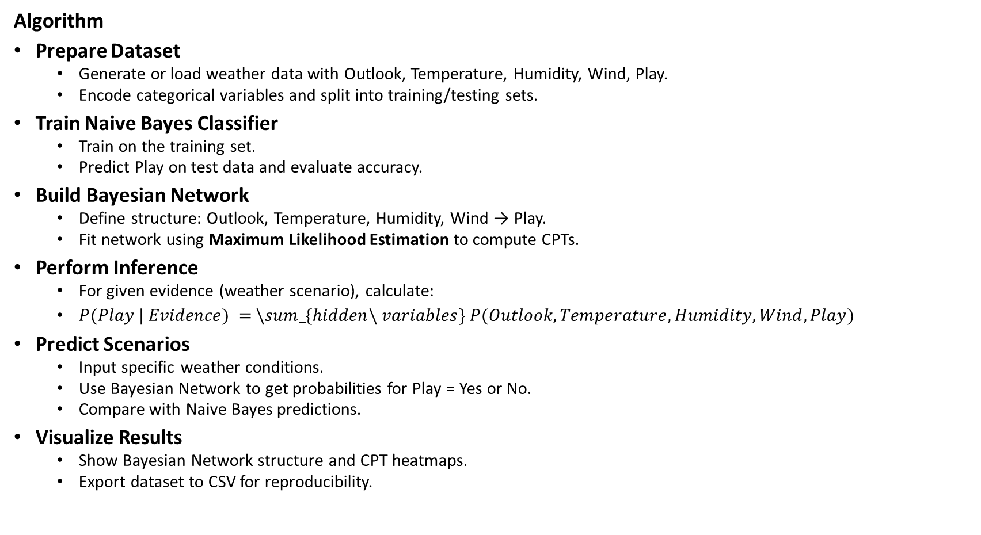
THEORETICAL BACKGROUND
Algorithm
Prepare Dataset
Generate or load weather data with Outlook, Temperature, Humidity, Wind, Play.
Encode categorical variables and split into training/testing sets.
Train Naive Bayes Classifier
Train on the training set.
Predict Play on test data and evaluate accuracy.
Build Bayesian Network
Define structure: Outlook, Temperature, Humidity, Wind → Play.
Fit network using Maximum Likelihood Estimation to compute CPTs.
Perform Inference
For given evidence (weather scenario), calculate:
$P(Play | Evidence) = \backslash sum_\{hidden\backslash variables\} P(Outlook, Temperature, Humidity, Wind, Play)$
Predict Scenarios
Input specific weather conditions.
Use Bayesian Network to get probabilities for Play = Yes or No.
Compare with Naive Bayes predictions.
Visualize Results
Show Bayesian Network structure and CPT heatmaps.
Export dataset to CSV for reproducibility.

Slide 5
IMPLEMENTATION AND CODE
Link to code in Git-hub Repository
List | Git-hub Repository Links
Implementation of Code Link | https://github.com/dharrini06/WeatherPredictionAI/blob/main/weather_prediction.py
Word Document Report Link | https://github.com/dharrini06/WeatherPredictionAI/blob/main/Weather%20Prediction%20AI%20project.docx
PPT Link | https://github.com/dharrini06/WeatherPredictionAI/blob/5b303c34095f5efe1d00307f42949aadb7eab5b6/Weather%20Prediction%20AI%20mini%20project.pptx

Slide 6
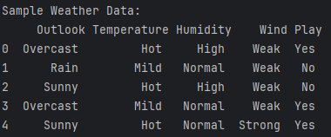
OUTPUT AND RESULTS
Sample Dataset Table
This table shows a sample of the generated weather dataset. Each row represents a scenario with Outlook, Temperature, Humidity, Wind, and the predicted outcome Play.

Slide 7
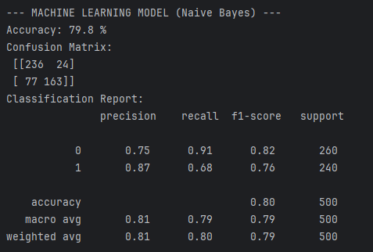
OUTPUT AND RESULTS
Naive Bayes Confusion Matrix
The confusion matrix illustrates the Naive Bayes classifier’s performance. It shows correct and incorrect predictions for Play = Yes and Play = No.

Slide 8
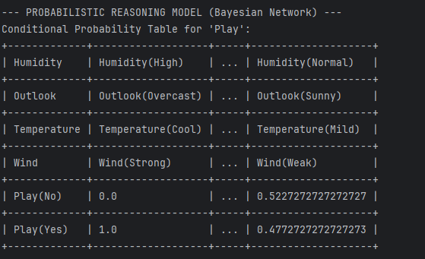
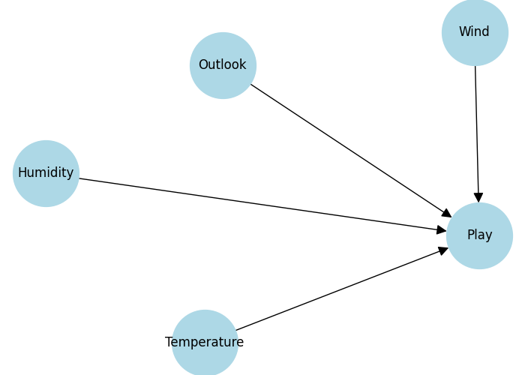
OUTPUT AND RESULTS
Bayesian Network Structure
This graph represents the Bayesian Network. Arrows indicate dependencies from weather variables (Outlook, Temperature, Humidity, Wind) to the decision Play.

Slide 9
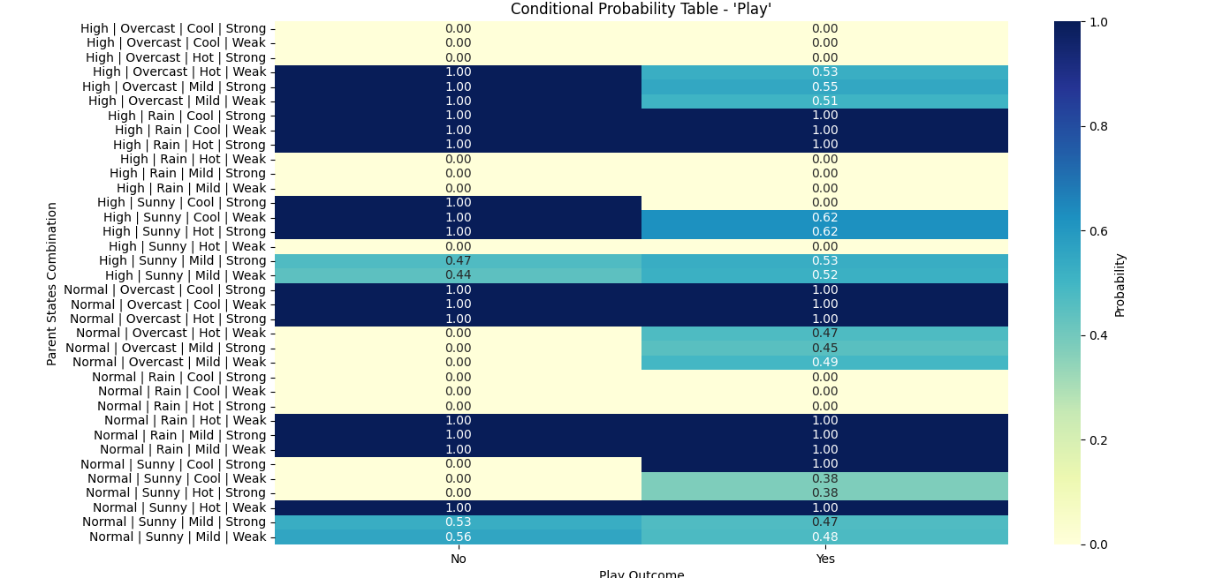
OUTPUT AND RESULTS
CPT Heatmap
This heatmap visualizes the conditional probabilities of Play given all combinations of parent variables. Darker colors indicate higher probabilities for each outcome.

Slide 10
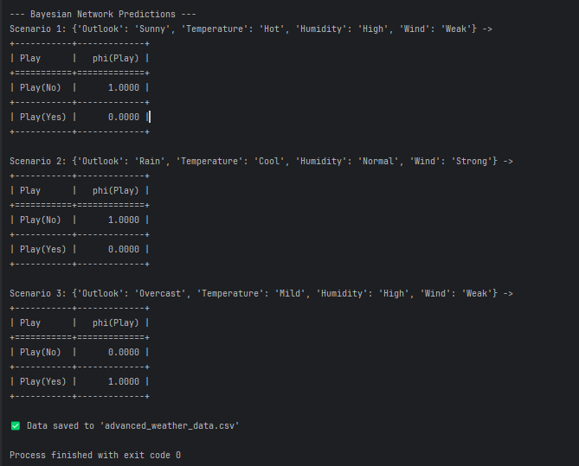
OUTPUT AND RESULTS
Scenario Prediction Table
These tables show Bayesian Network predictions for example weather scenarios. Probabilities indicate the likelihood of playing (Play = Yes) or not playing (Play = No).

Slide 11
OUTPUT AND RESULTS
Results
The Bayesian Network successfully predicts the probability of playing (Play) under different weather scenarios.
The model captures dependencies between weather variables (Outlook, Temperature, Humidity, Wind) and the outcome.
Predictions are consistent with expected behavior, e.g., Overcast usually results in Play = Yes.
The Naive Bayes classifier provides comparable accuracy, validating the synthetic dataset and feature encoding.
Visualizations (Bayesian Network structure and CPT heatmap) clearly show how different factors influence the decision.
The system efficiently computes probabilities for multiple scenarios in real-time.
Compared to simpler approaches, the Bayesian Network provides interpretable, probabilistic reasoning, handling uncertainty better than standard classifiers.

Slide 12
OUTPUT AND RESULTS
Future Enhancements
Incorporate real-time weather data from APIs (e.g., OpenWeatherMap) to make predictions more accurate and dynamic.
Extend the model to predict multiple weather-dependent activities, not just outdoor play.
Integrate additional features like season, time of day, or location to improve predictive power.
Combine Bayesian Networks with machine learning ensembles (e.g., Random Forest, Gradient Boosting) for better accuracy.
Develop a web or mobile interface where users can input weather conditions and get probabilistic predictions instantly.
Implement explainable AI techniques to show which weather factors most influence the outcome.
Include uncertainty visualization, e.g., probability ranges instead of single predictions.

Slide 13
REFERENCES
References
Russell, S., & Norvig, P. (2020). Artificial Intelligence: A Modern Approach (4th Edition). https://aima.cs.berkeley.edu/
TutorialsPoint – Naive Bayes Classifier in AI. https://www.tutorialspoint.com/machine_learning_with_python/machine_learning_with_python_naive_bayes_algorithm.htm
GeeksforGeeks – Bayesian Network in Python. https://www.geeksforgeeks.org/bayesian-network-in-python/
Towards Data Science – Understanding Bayesian Networks and Probabilistic Reasoning. https://towardsdatascience.com/bayesian-networks-in-python-1caa5d6ff312
Python Official Documentation – Matplotlib Visualization. https://matplotlib.org/stable/api/pyplot_api.html
Python Official Documentation – Pandas Documentation. https://pandas.pydata.org/docs/

